Slide 1
Okapi
Khushi K

Slide 2
Okapi-BM25 ranking Algorithm
BM stands for Best Match
It is ranking function used by search engines to estimate relavance of documents to a given search query.
BM25 extends the scoring function for the binary independence model to include documet and query term weights.

Slide 3


The simplest score of a document d is just idf weighting of the query terms present in the document:
Improving this formula by facctoring in the term frequency and document lenghth

Slide 4
Tftd: term frequency in document d
L_{d}/L_{ave} :Length of document d (average document length in the whole collection)
K1: tuning parameter controlling the document tem frequency scaling
b: tuning parameter controlling the scaling by document length

Slide 5

There are some variations of the scoring function for BM 25,the most common form is :

Slide 6
r_{i} is the number of relevant documents containing term i
N_{i} is the number of documents containing term I
N is the total number of documents in collection
R is the number of relevant documents for query
r and R are set to zero if there is no relevannce information
f_{i} is the frequency of term i in the document
qf_{i} is the frequency of term i in the query

Slide 7

K is more complicated parameter that normalizes tf component by document length. Specially
The constant b regulates the impact of length normalization,wher b= 0 corresponds to no length normalization, and b= 1 is full normalization.

Slide 8
Query with two terms, “president lincoln”, (qtf = 1)
No relevance information (r and R are zero)
N = 500,000 documents
“president” occurs in 40,000 documents (df₁ = 40, 000)
“lincoln” occurs in 300 documents (df₂ = 300)
“president” occurs 15 times in the doc (tf₁ = 15)
“lincoln” occurs 25 times in the doc (tf₂ = 25)
document length is 90% of the average length (dl/avdl = .9)
k₁ = 1.2, b = 0.75, and k₂ = 100
K = 1.2 · (0.25 + 0.75 · 0.9) = 1.11

Slide 9
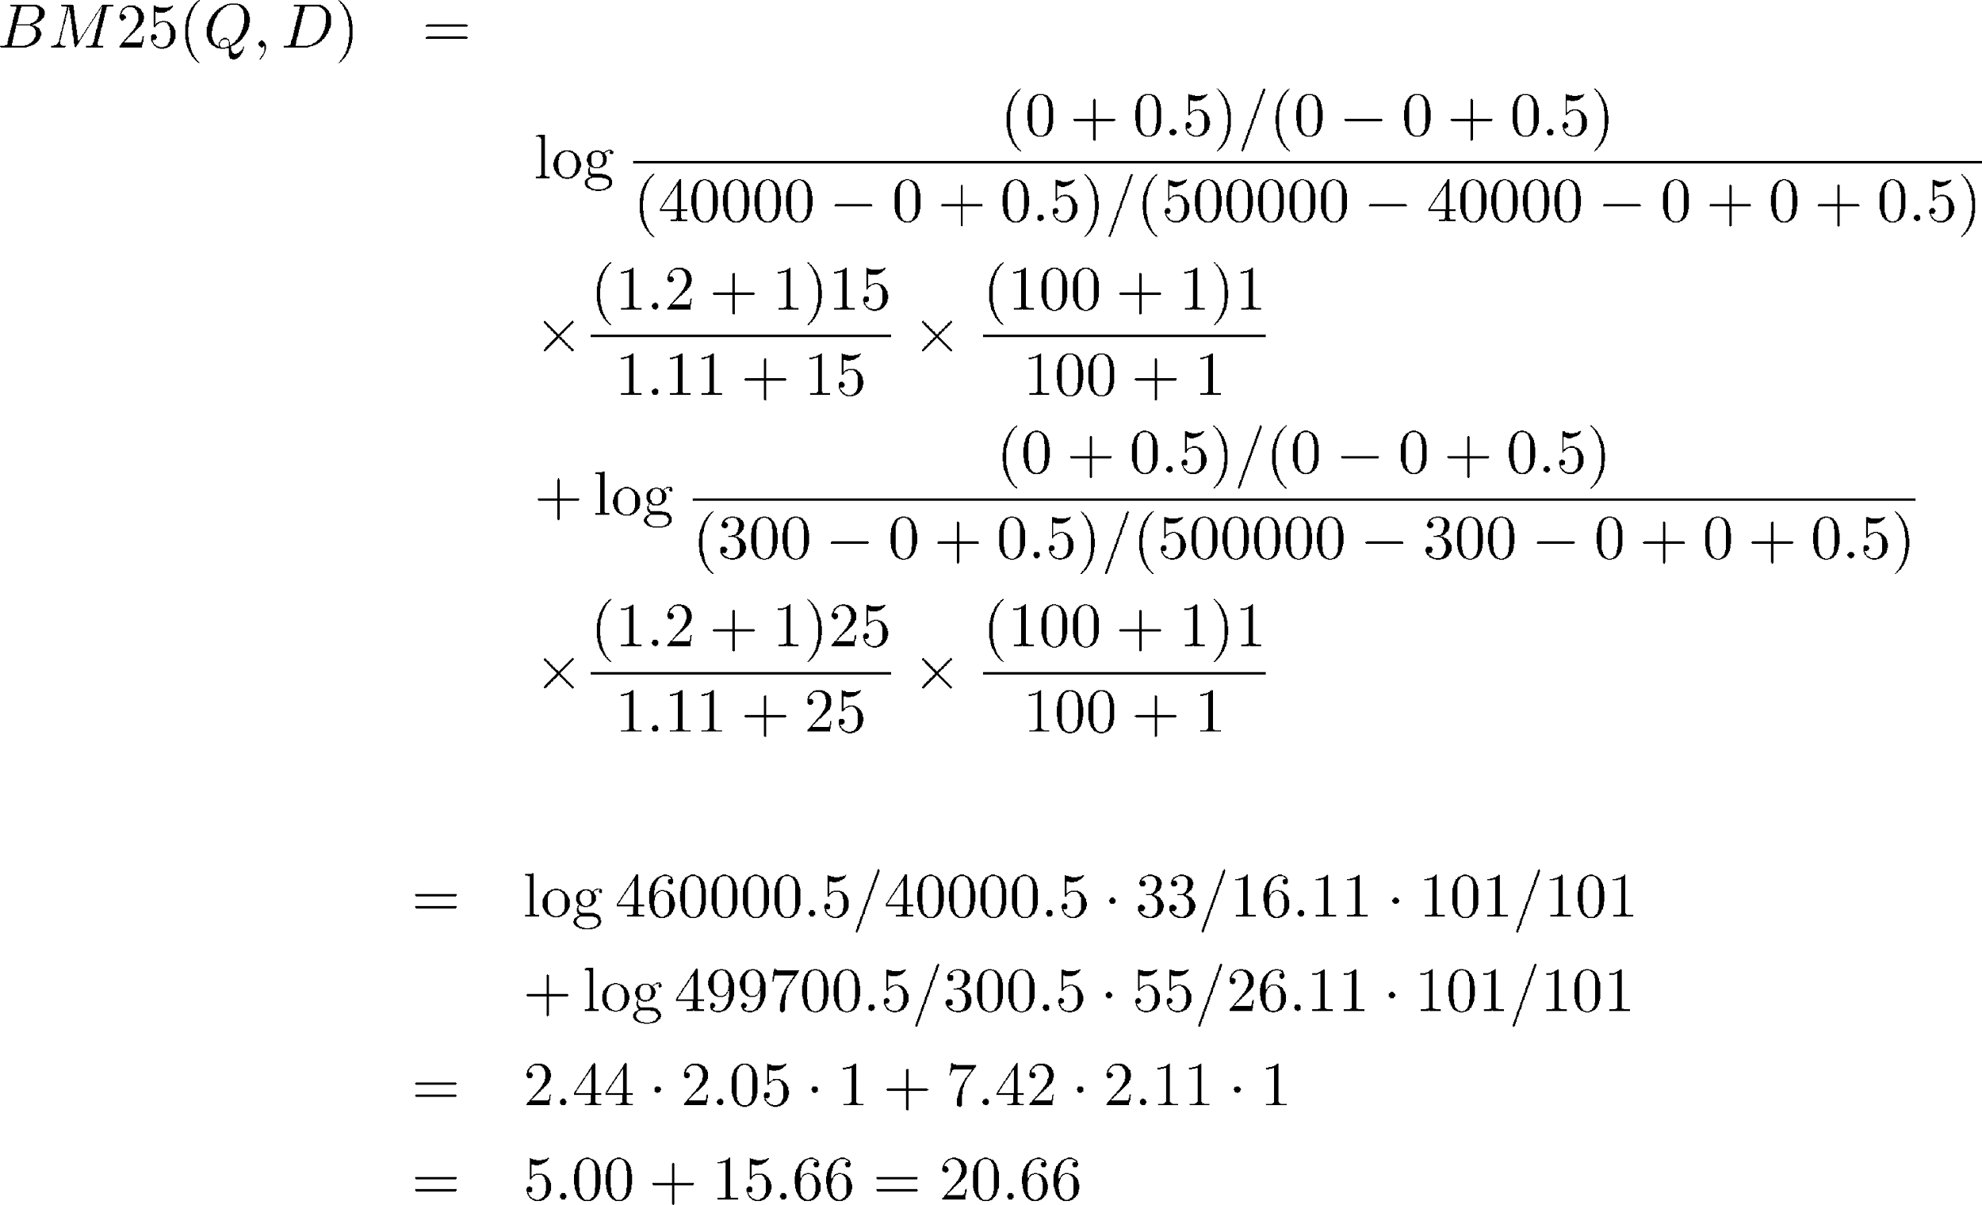
We will consider the typical case where we have no relevance information (r and R are zero).

Slide 10
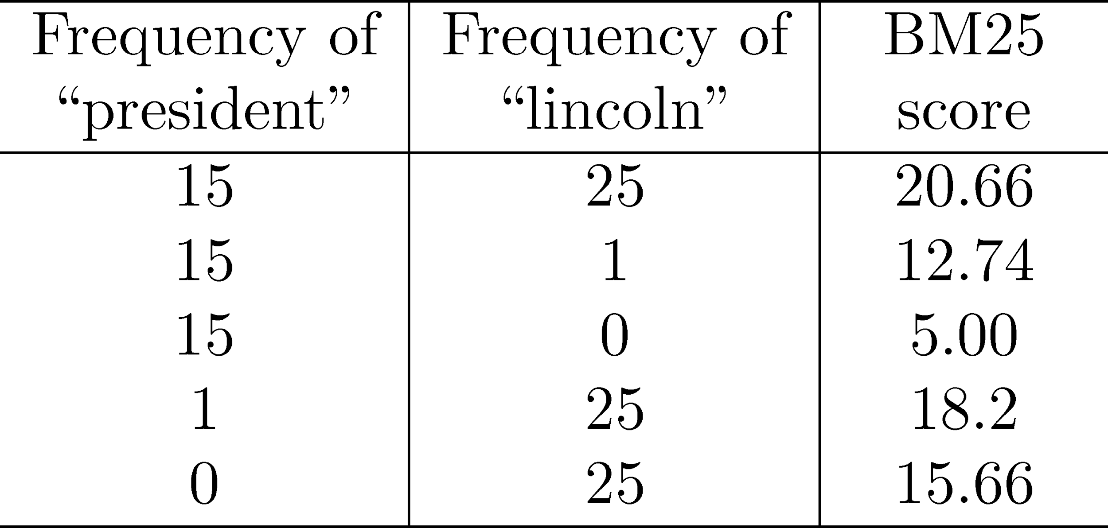
Effect of term frequencies in BM25

Slide 11
Conclusion
Okapi gives scores for different numbers of term occurrences.
This shows the importance of the “lincoln” term andthat even one occurrence of a term can make a large difference in the score.
Reducing the number of term occurrences from 25 or 15 to 1 makes a significant difference.

